Slide 1
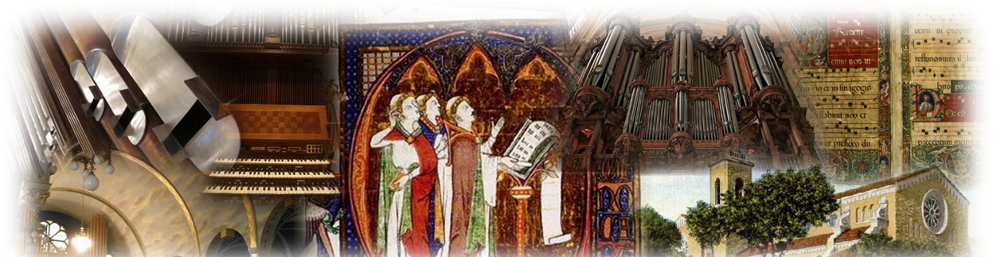
Sacred Music
Zipoli Institute

Slide 2
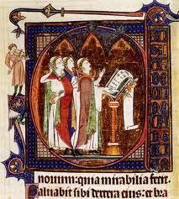
Gregorian chant
An Introduction

Slide 3
What is it?
Sacred Music of the Church
Thousands of years of combined knowledge
Ancient Jewish and Greek roots
Ancient Tradition, Magisterium, and Scripture
Aural chant later developed into notation

Slide 4
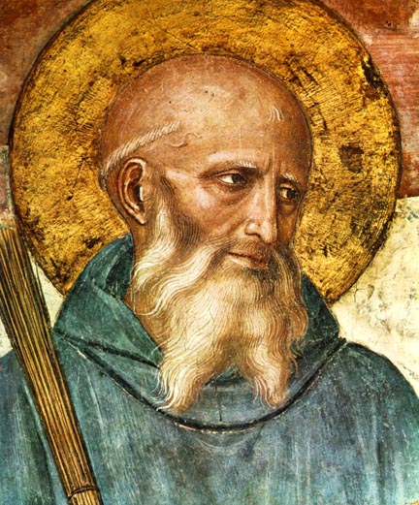
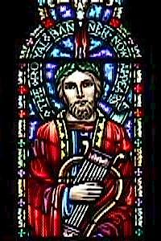
Origin
Ancient Psalmody
Monastic Hours
St. Benedict (480-547)
St. Venantius Fortunatus (c.530-600)
Notes:
Pange Lingua poetry, Vexilla Regis

Slide 5
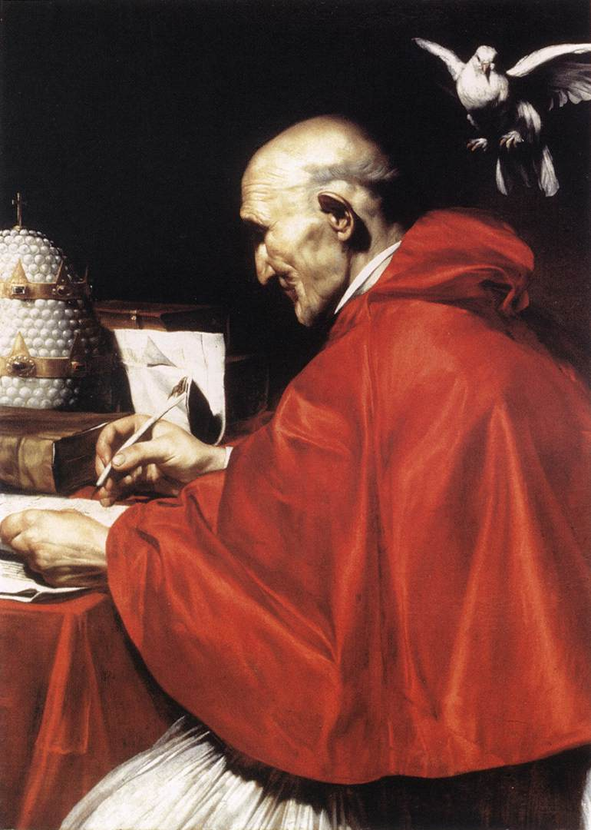
Pope St. Gregory the Great (c.540-604)

Slide 6
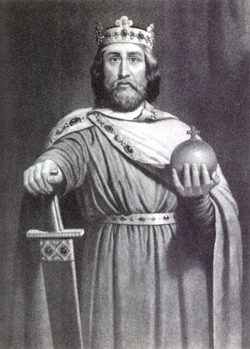
Chant receives endorsement
Charlemagne, King of Franks, Roman Emperor (c.742-814) Built empire Cultural flourish Chant is widespread

Slide 7
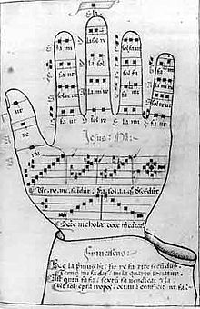
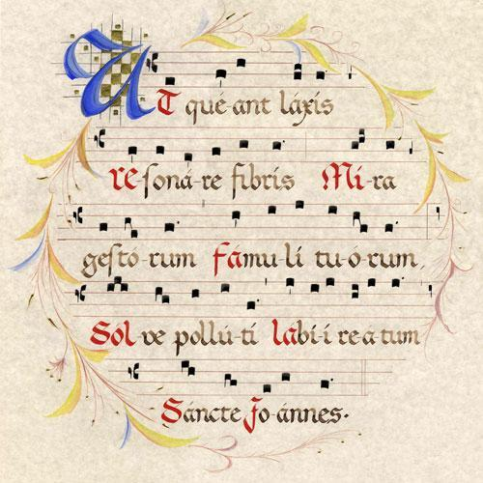
Guido d’Arezzo, OSB
C.991-1033
Noted monks having difficultly memorizing chants
Developed sight singing method, NOTATION!

Slide 8
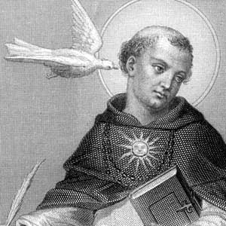
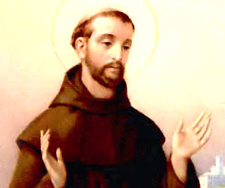
Monastic cultivation
Eastern Monasticism
St. Thomas Aquinas
St. Francis

Slide 9
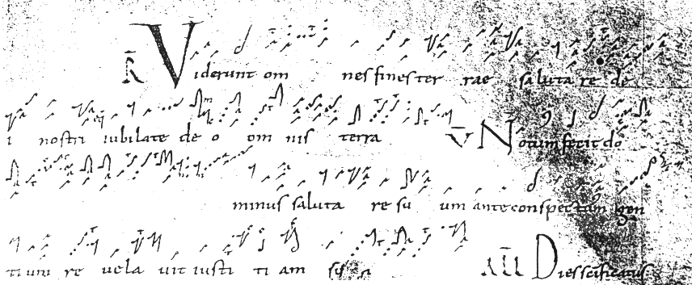
Chant as foundation of Western music
Perotin, c. 1198 – added parts to chant

Slide 10
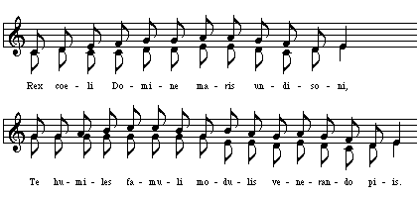
13th Century and following
Organum and Polyphony grew alongside chant

Slide 11
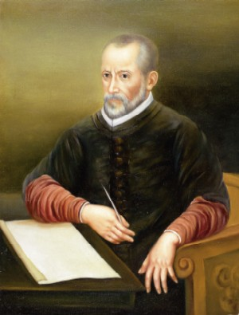
Reformation, Council of Trent
16th Century
Reaffirmed Gregorian chant - supreme model
even amidst growing protestant hymnody

Slide 12
1900-present

Slide 13
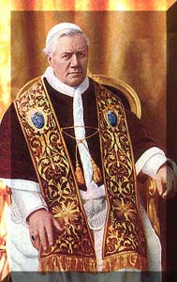
Pope St. Pius X
Gregorian Chant is the supreme model for sacred music
“The more closely a composition for church approaches in its movement, inspiration and savor the Gregorian form, the more sacred and liturgical it becomes; and the more out of harmony it is with that supreme model, the less worthy it is of the temple.”

Slide 14
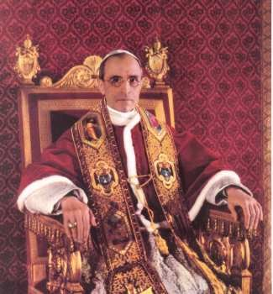
Ven. Pope Pius XII
“Sacred music, through the course of centuries, has traversed a long road by which, it has finally reached the heights: simple and natural Gregorian modes, which are, moreover, quite perfect in their kind, to great and even magnificent works of art.”
“The Church also must, from time to time, impose a check lest its proper purposes be exceeded and lest, along with the true progress, an element profane and alien to divine worship creep into sacred music and corrupt it."

Slide 15
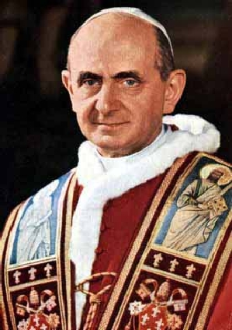
Pope Paul VI
Down the centuries, Gregorian chant has accompanied liturgical celebrations in the Roman rite, has nourished men's faith and has fostered their piety, while in the process achieving an artistic perfection which the Church rightly considers a patrimony of inestimable value and which the Council recognized as "the chant especially suited to the Roman liturgy."
Issued “Jubilate Deo” in 1974

Slide 16
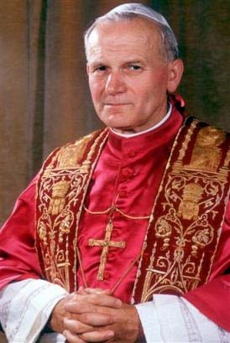
Ven. Pope John Paul II
“The Christian community must make an examination of conscience so that the beauty of music and song will return increasingly to the liturgy.” Centenary of Pius X’s document, 2003.

Slide 17
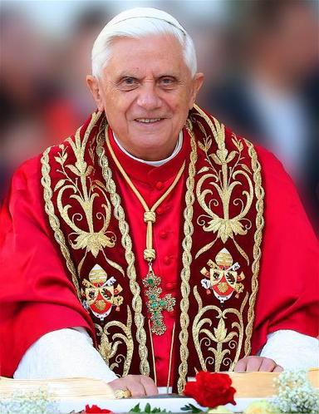
Pope Benedict XVI
"An authentic updating of sacred music can take place only in the lineage of the great tradition of the past, of Gregorian chant and sacred polyphony.“ [Pope Benedict XVI - Speaking in the Sistine Chapel, June 24, 2006.]

Slide 18
Lord, you have the words of eternal life.
Church Music:
has been handed down through the centuries Music of the Church Predominance in Sacred Liturgy

Slide 19
Chant Notation
2 Clefs
1 flat

Slide 20
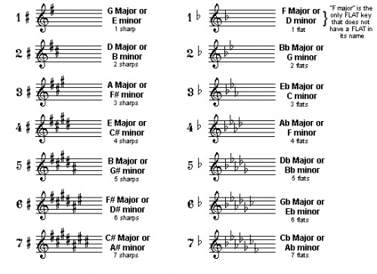
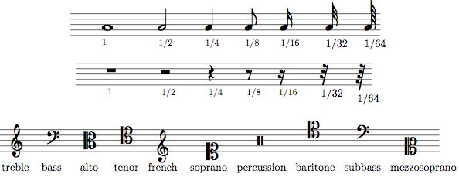
Modern Western notation

Slide 21
Round vs. Square
Modern Notation | Chant
5 lines | 4 lines
30+ key signatures | no key signature (eight modes)
# b x bb | b
Whole, half, quarter, 8th, 16th, 32nd, etc. | Even in length
Accents, multiple rests, slurs, ties, phrases, etc. | Breath markings, holds
Rhythmic focus, driven by notes | Text focus, text painting
Frequent, large skips | Mostly stepwise motion
Hard to transpose | Sung on any pitch!

Slide 22
Ok, how do I read it?
If modern music is from Gregorian chant,
why is chant so foreign to us?

Slide 23
All chant is based on a few note types!
Neume

Slide 24
Podatus (2 neumes stacked on top)
sing bottom note first

Slide 25
Left to right
Notes:
Clivis

Slide 26
Notes:
3 notes - Porrectus

Slide 27
End of line: marks next note
Notes:
Custos

Slide 28
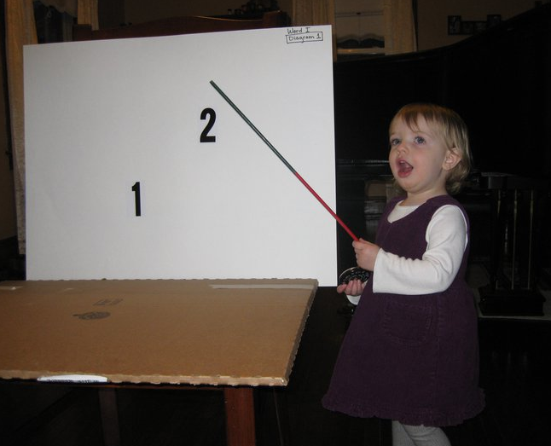
Practice!
Notes:
Now that you’re smart and know the notation a little bit, we need to practice.

Slide 29
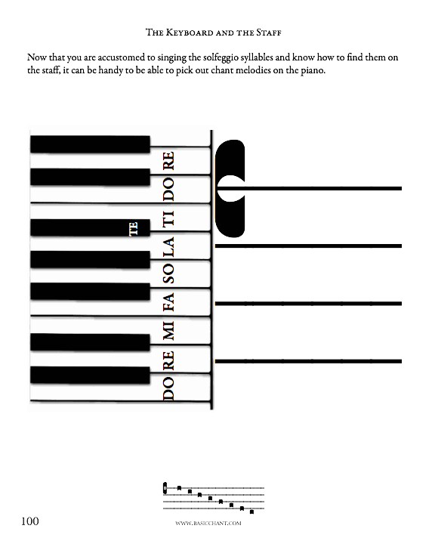

Slide 30
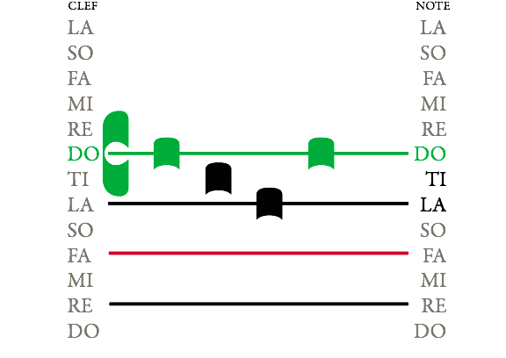

Slide 31
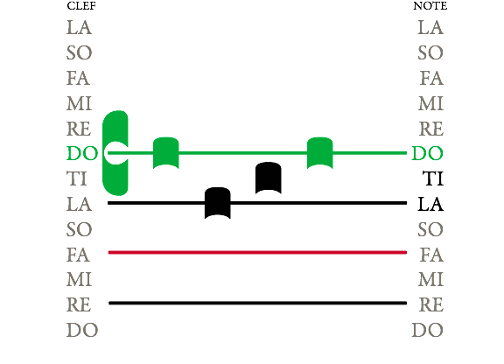

Slide 32
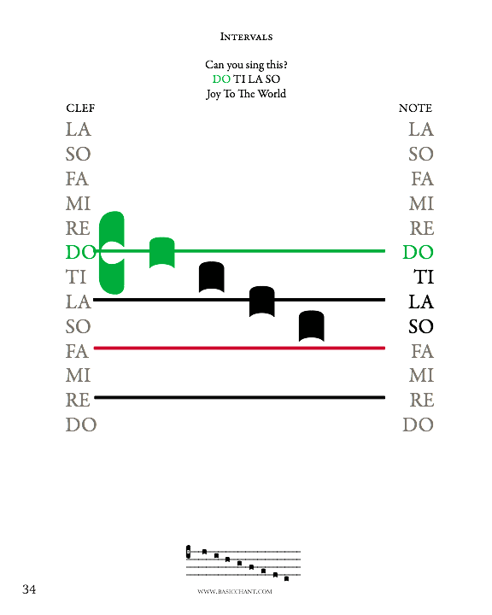

Slide 33
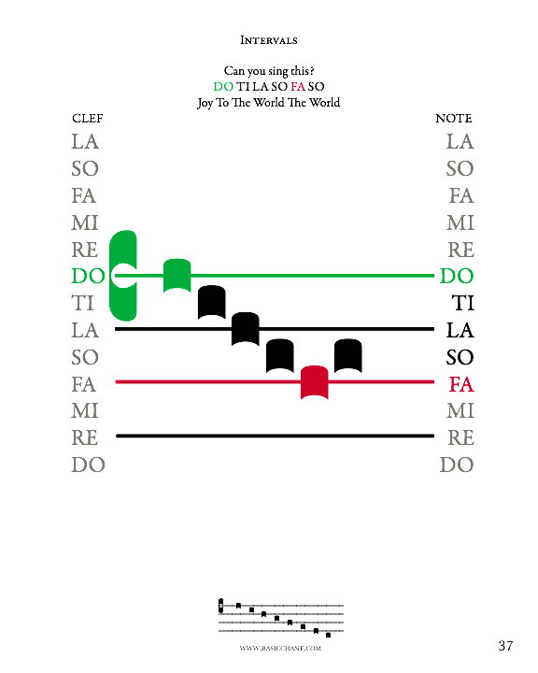

Slide 34
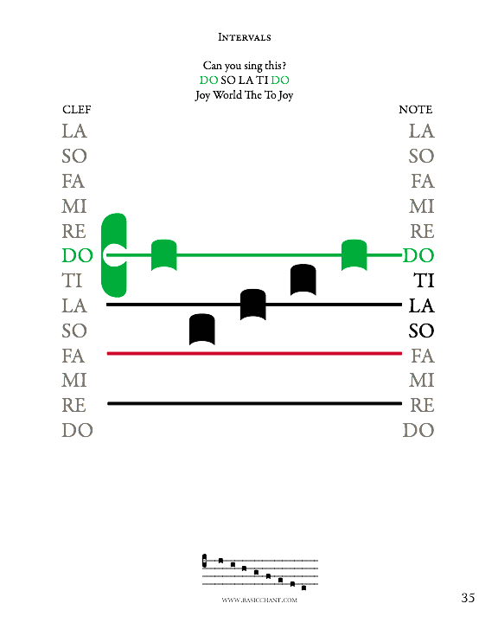

Slide 35
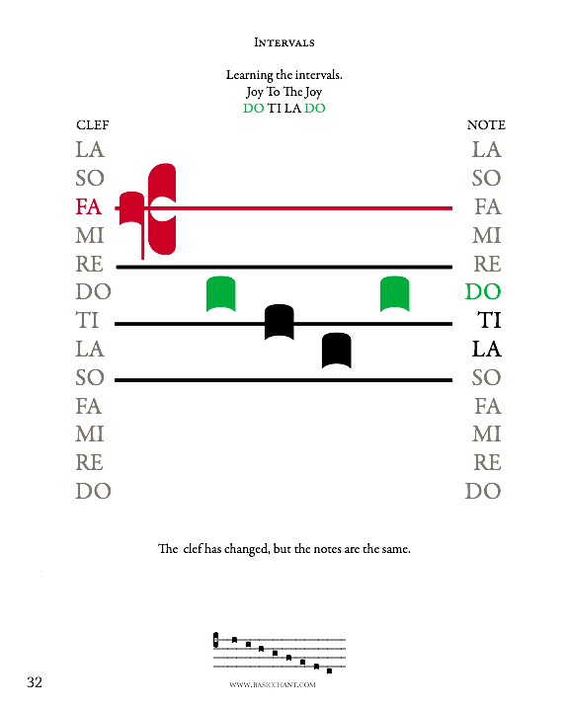

Slide 36
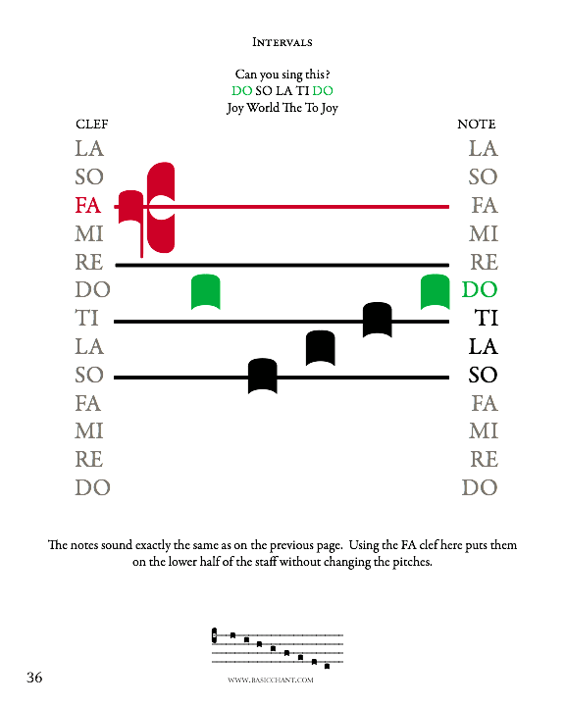

Slide 37
Groups of falling notes, often diamond shaped, but not faster.

Slide 38
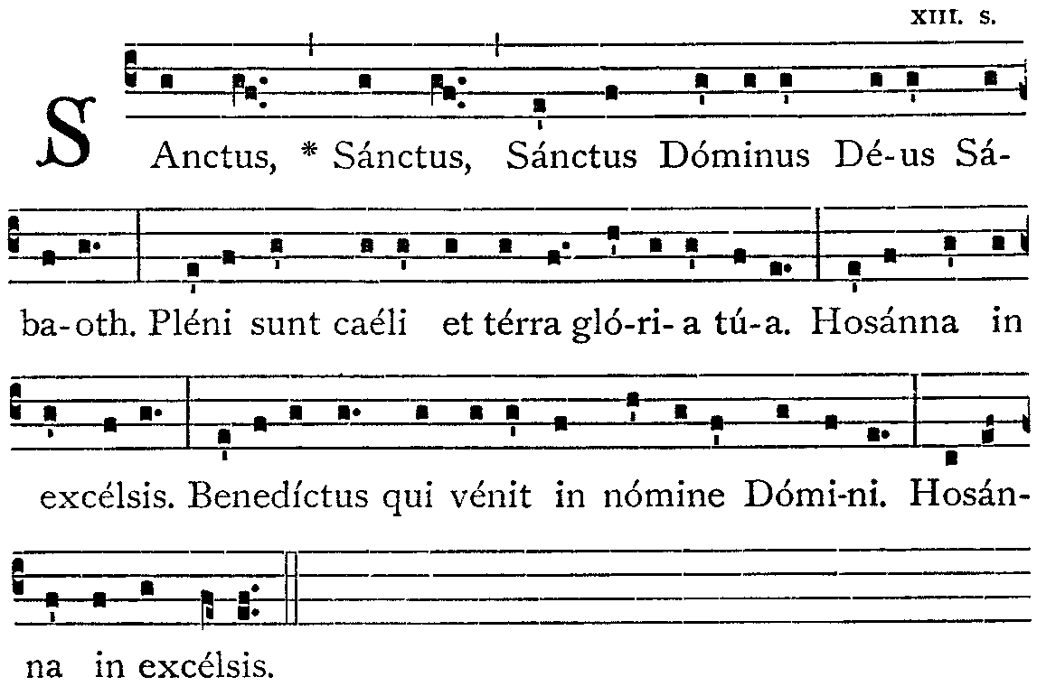

Slide 39
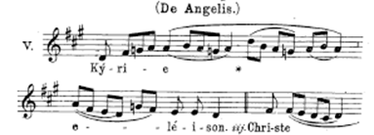
In Review
Chant is more accurate

Slide 40
In Conclusion
Chant is our “Treasure of inestimable value”
Has “Pride of place” at Mass
Chant is:
Vocal
Text focused
Smooth and flowing
Mostly non-rhythmic
Universal
Can be in Latin or vernacular
Holiness
Beauty of form
Reverence
Integral to Mass

Slide 41
End Intro Q&A

Slide 42
Intermediate Chant Notation and Phrasing

Slide 43
Podatus
Lower note is slightly louder

Slide 44
Salicus
Notes:
Salicus

Slide 45
Quilisma
Slight hold on first note.
Notes:
Quilisma

Slide 46
Liquescent
Phonate the consonant!
Notes:
Liquescent

Slide 47
Pressus

Slide 48
Distropha and Tristropha

Slide 49
Phrasing
Chant is music too! Sing with beauty.
Rests, commas, half and full phrases
Antiphon/Psalm
Entire piece as whole

